Slide 1
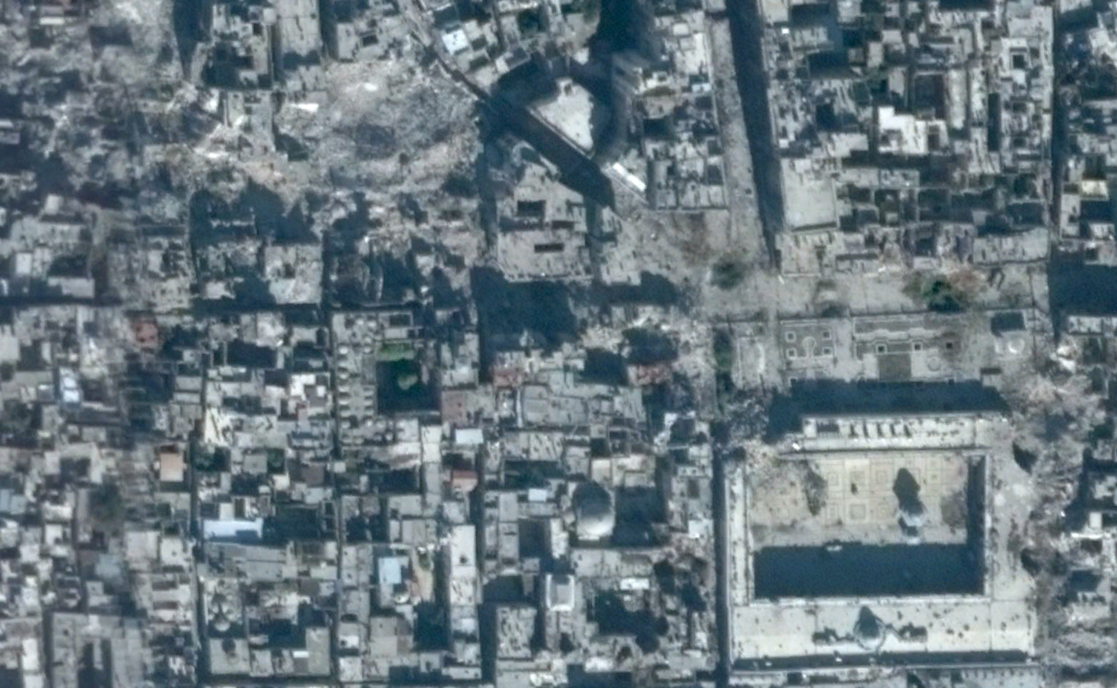
2. Introduction to Plotting with ggplot2
Jonathan Hersh, PhD (Chapman Argyros School of Business)
4/8/22

Slide 2
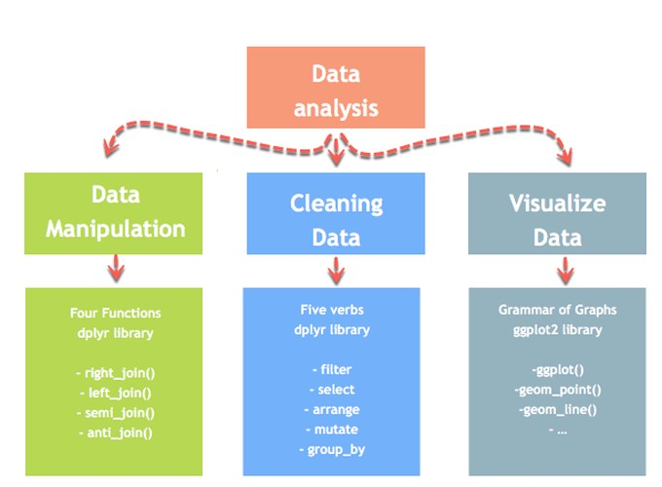
Data Manipulation Process

Slide 3
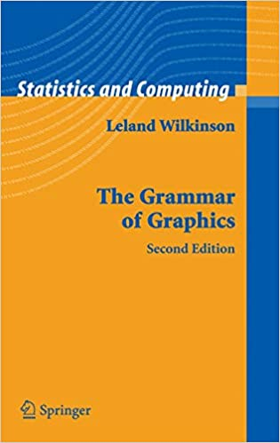
Language follows grammar
The boy hit the ball
S
V
O
Can graphics follow a grammar?

Slide 4
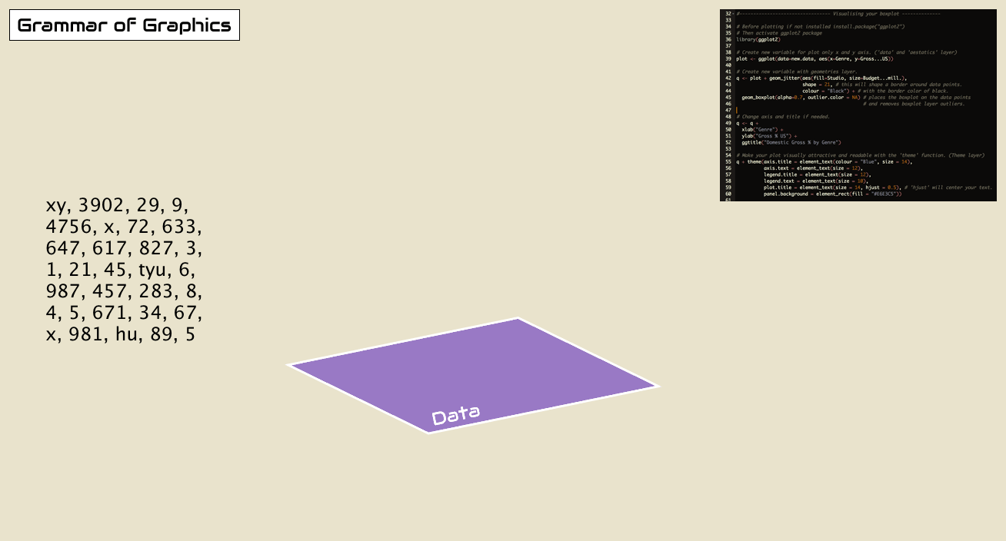

Slide 5
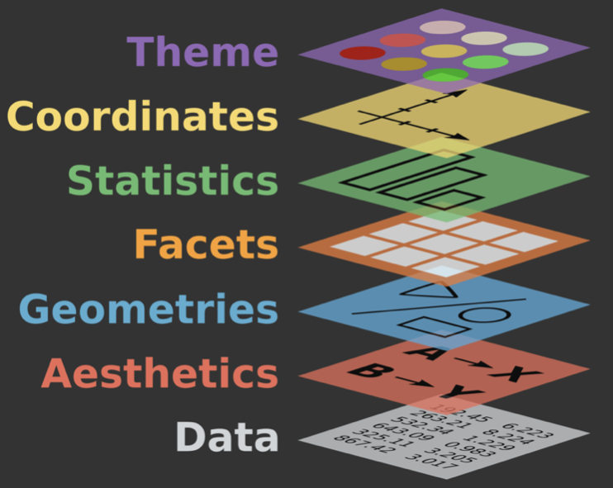
Seven grammar elements of every plot
Data: What is the data you want to visualize?
Aesthetics: What data will be on the x and y axes?
Geometry: What shapes (bars, lines, points) will you use to represent your data?
Facets: Will your data be split into multiple plots? If so, how?
Statistics: Will you use statistical summarizes on your data (e.g. smoothing lines)
Coordinates: What’s the numeric plotting space?
Themes: What is the visual identity (fonts, size, colors)?

Slide 6
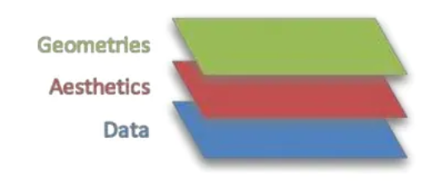
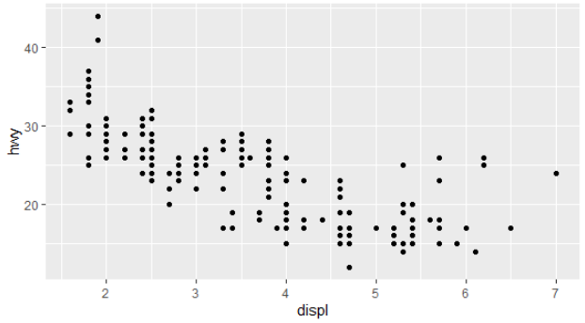
Layers 1-2-3: Data – Aesthetics - Geometries
library('ggplot2')
data(mpg)
ggplot(data = , (x = displ, y = hwy)) +
mpg
aes
geom_point()

Slide 7
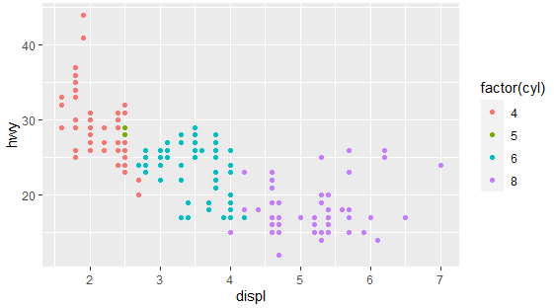
Layers 1-2-3: Data – Aesthetics - Geometries
Let’s change the aesthetic by coloring points by number of cylinders
library('ggplot2')
data(mpg)
ggplot(data = mpg, aes(x = displ, y = hwy, color = cyl)) + geom_point()

Slide 8
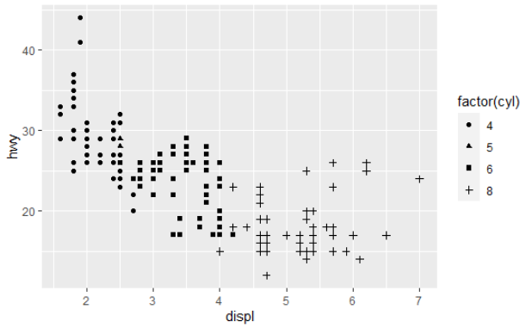
Layers 1-2-3: Data – Aesthetics - Geometries
Let’s change the shape of the points
library('ggplot2')
data(mpg)
ggplot(data = mpg, aes(x = displ, y = hwy, shape = cyl)) + geom_point()

Slide 9
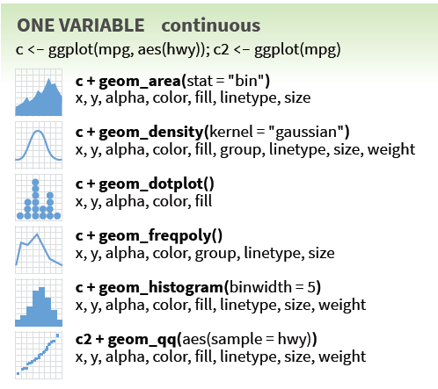
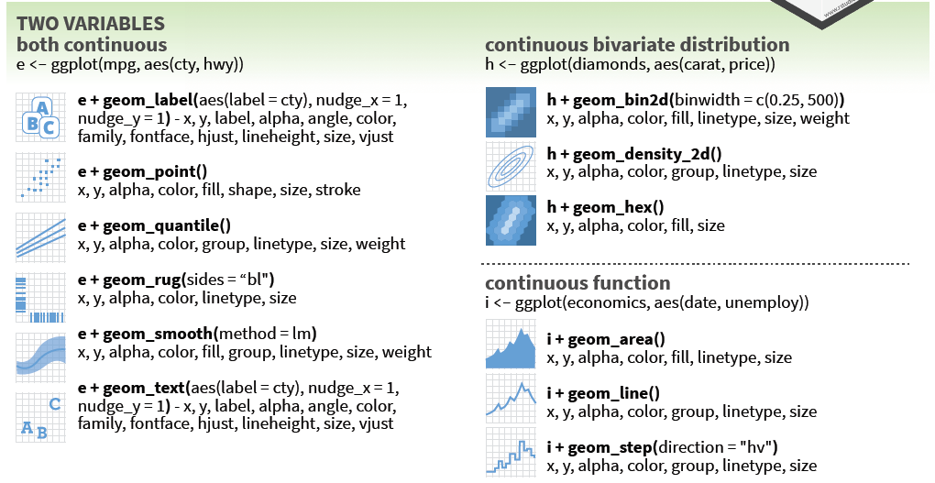
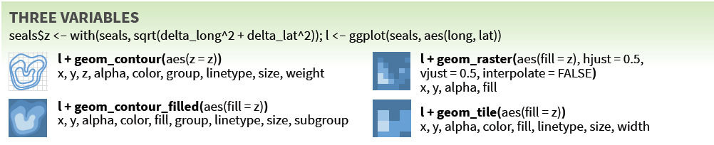
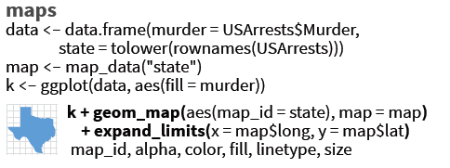
Example geometries
Data: What is the data you want to visualize?
Aesthetics: What data will be on the x and y axes?
Geometry: What shapes (bars, lines, points) will you use to represent your data?
Facets: Will your data be split into multiple plots? If so, how?
Statistics: Will you use statistical summarizes on your data (e.g. smoothing lines)
Coordinates: What’s the numeric plotting space?
Themes: What is the visual identity (fonts, size, colors)?

Slide 10
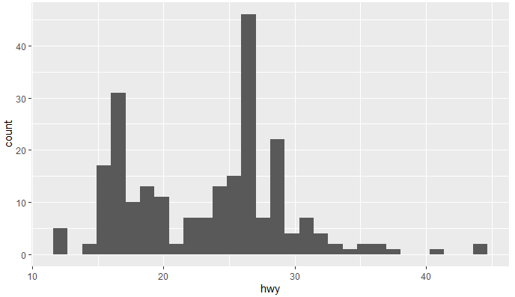
Layers 1-2-3: Data – Aesthetics - Geometries
Let’s create a histogram for highway mile per gallon
ggplot(data = mpg, aes(x = hwy)) + geom_histogram()

Slide 11
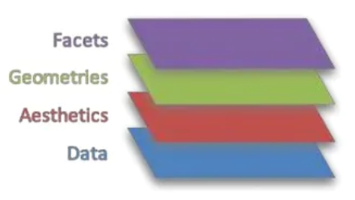
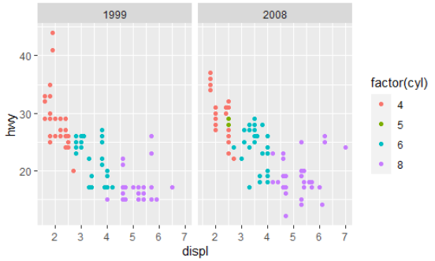
Layer 4: Facet
We have data from two years
Let’s plot that data side by side
ggplot(data = mpg, aes(x = displ, y = hwy, shape = cyl)) + geom_point() +
facet_wrap(~ year)

Slide 12
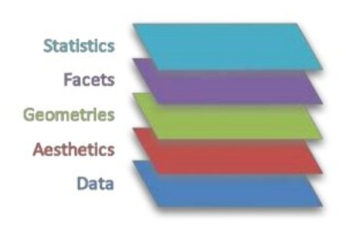
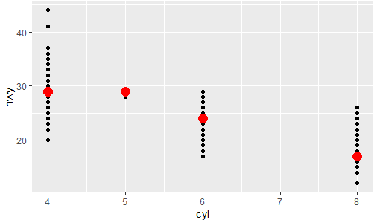
Layer 5: Statistics
Let’s add a layer that adds the median value of highway miles per gallon for each cylinder
ggplot(data = mpg, aes(x = cyl, y = hwy)) +
geom_point() +
stat_summary(fun = "median", color = "red", size = 1)

Slide 13
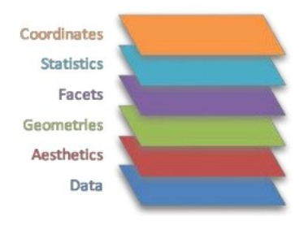
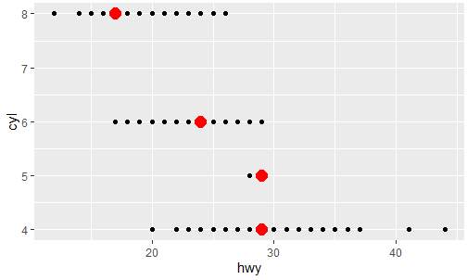
Layer 6: Coordinates
Let’s change the coordinates
ggplot(data = mpg, aes(x = cyl, y = hwy)) +
geom_point() +
stat_summary(fun = "median", color = "red") +
coord_flip()

Slide 14
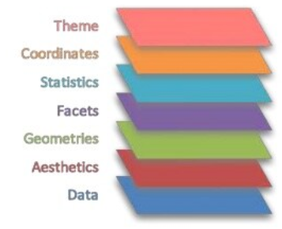
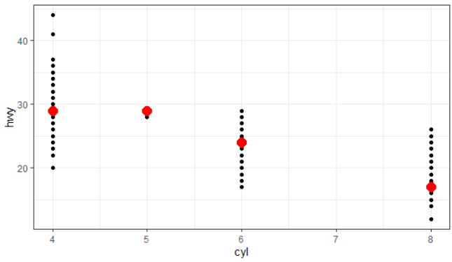
Layer 7: Themes
Themes alter the font, color according to pre-determined rules
ggplot(data = mpg, aes(x = cyl, y = hwy)) +
geom_point() +
stat_summary(fun = "median", color = "red", size = 1) +
theme_bw( ) +

Slide 15
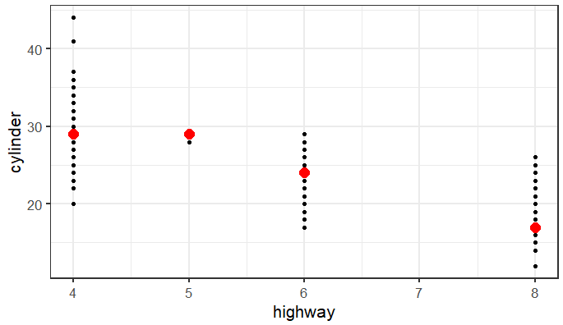
Layer 7: Axes labels and font size
I always recommend labeling axes titles clearly
Fonts are often too small so I recommend increasing to font size 14, 16, or 18.
ggplot(data = mpg, aes(x = cyl, y = hwy)) +
geom_point() +
stat_summary(fun = "median", color = "red") +
theme_bw(base_size = 16) +
labs(x = "highway", y = "cylinder")

Slide 16
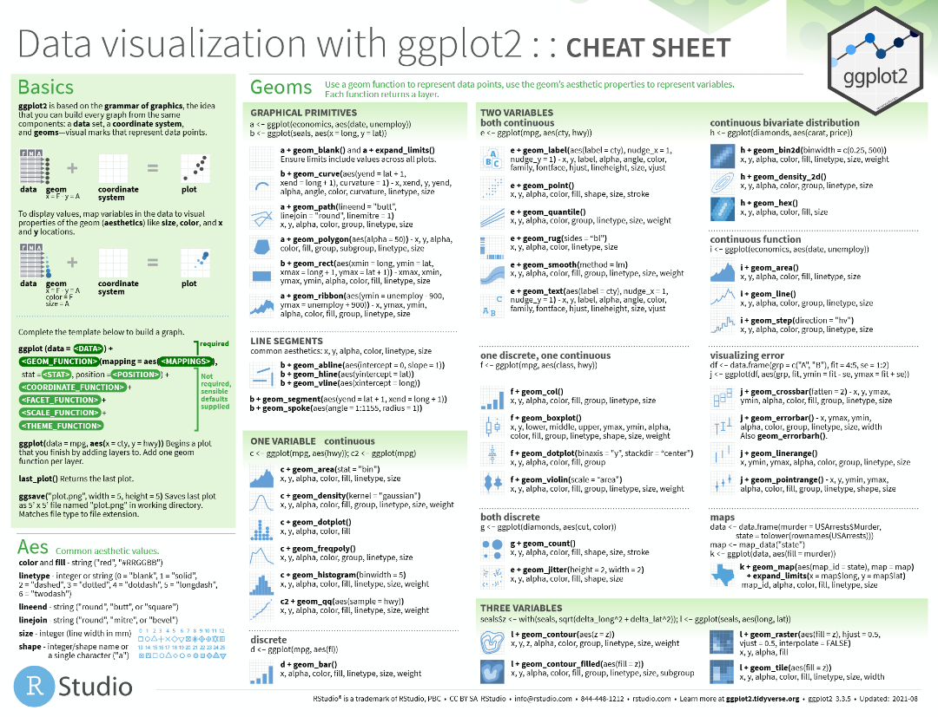
https://github.com/rstudio/cheatsheets/blob/master/data-visualization-2.1.pdf

